Slide 1

How we can Learn from Tracking Fatal Encounters
By LATEEF MEDLEY

Slide 2
“Secrecy in police work is not only undesirable but unwarranted. Accountability means being responsive to the problems and needs of citizens. It also means managing police resources in the most cost-effective manner. It must be remembered that the power to police comes from the consent of those being policed.”
- The Community Relations Service (CRS), a component of the U.S. Department of Justice.

Slide 3
GLOSSARY
Fatal Encounter - an encounter in which a US civilian made contact with representative(s) from one or more law enforcement agencies and died Does not include civilians who died in law enforcement custody

Slide 4
End User Specification
This presentation was designed for:
Nonprofit Civil Rights Organizations
Government Agencies overseeing law enforcement agencies
Law Enforcement Agencies
The General US Public

Slide 5
The Purpose
The goal of this work is to provide a look into what has happened regarding civilian fatal encounters with police over the last 20 years by region and to predict what may happen based on the trends and seasonality we have already observed. I hope that this information will enlighten civilians, law enforcement agencies, and overseeing agencies of the risk of ignoring problems in policing today.

Slide 6
The Problem
These encounters, when negatively viewed by the public make this line of work more dangerous for everyone involved. One of the major problems regarding this work is that comprehensive reporting and analytics regarding this matter on a national scale is scarce. That may be because there are over 10,000 law enforcement agencies, reporting is optional in some cases, and there are major inconsistencies in how reporting is done, which lends itself to the unhealthy narrative that there is secrecy in public policing.

Slide 7
Quick Note about the availability of this data
“The nation’s leading law enforcement agency [FBI] collects vast amounts of information on crime nationwide, but missing from this clearinghouse are statistics on where, how often, and under what circumstances police use deadly force. In fact, no one anywhere comprehensively tracks the most significant act police can do in the line of duty: take a life,” according to the Las Vegas Review-Journal in its series Deadly Force (Nov. 28, 2011)
During my search for this data I can say that some summary statistics are available to the public, but I had a hard time finding a tabular form of encounters.

Slide 8
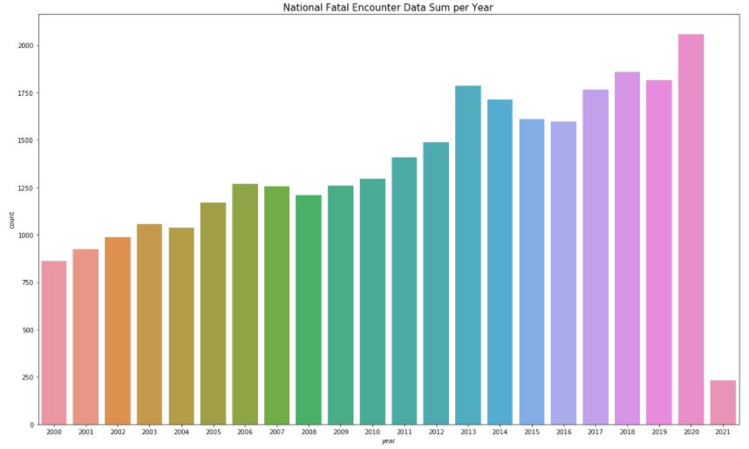
Sum of Fatal Encounters Since Jan 1, 2000
Notice the increasing trend of total Fatal Encounters per year.
It’s easy to look at this as just a graph, but each bar is hundreds of lives lost.

Slide 9
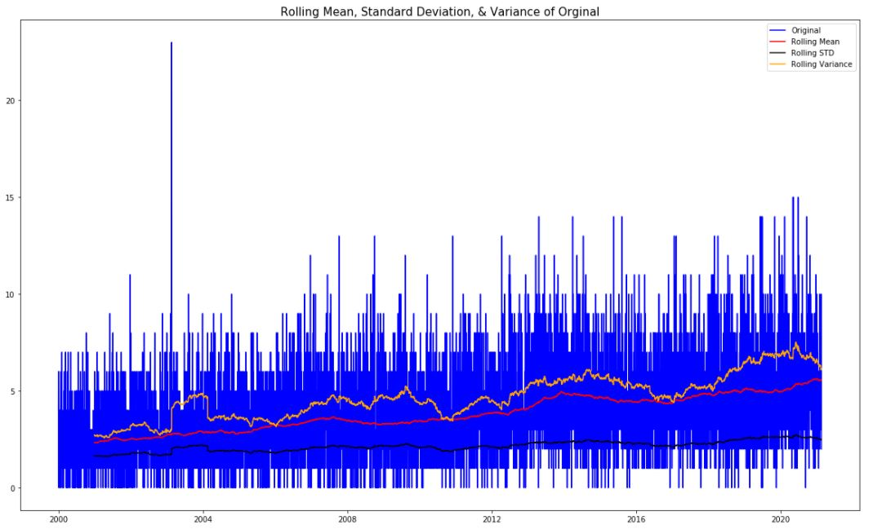
National Fatal Encounter Time Series (Fatal Encounters Per Day)

Slide 10
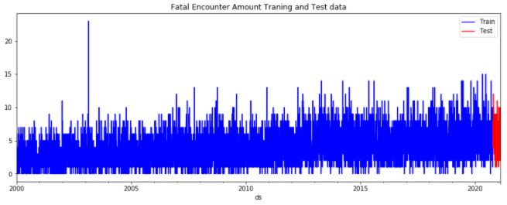
Train Test Split
Blue is used to train the Model
Red is used to test the model

Slide 11
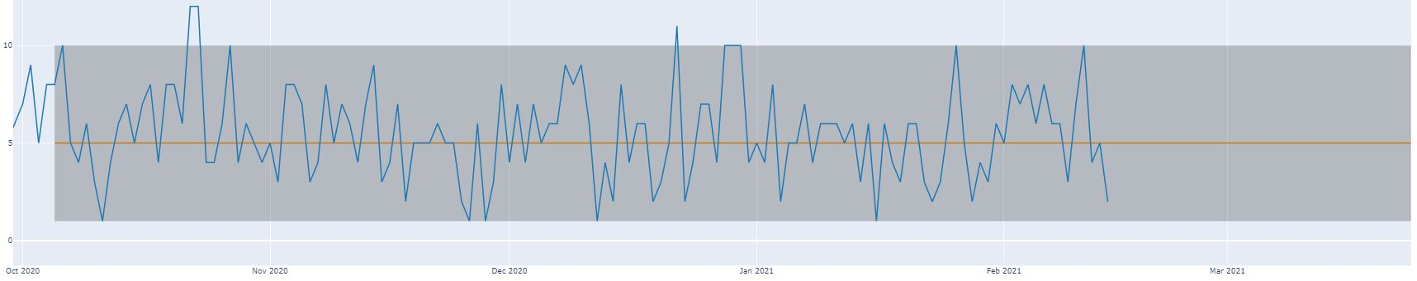
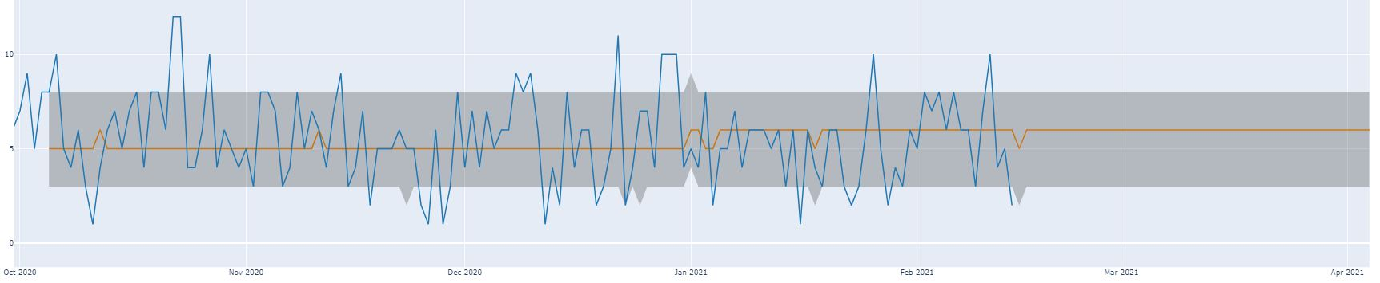
ARIMA VS FBPROPHET MODELS (Prediction in Orange – Actual in Blue)
ARIMA MODEL
MAE SCORE : 1.9174
MSE SCORE : 6.0
fbProphet MODEL
MAE SCORE : 1.909
MSE SCORE : 6.19
Based on the view I would conclude that the ARIMA model performed a little better considering how it’s upper and lower bounds makes it less sensitive to fluctuations in the data.

Slide 12
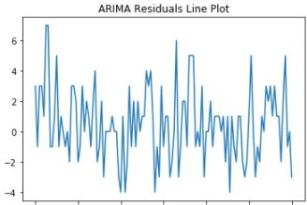
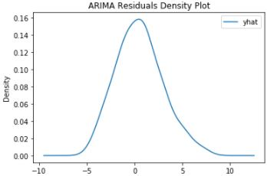
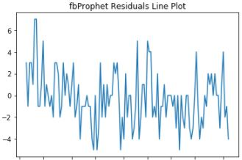
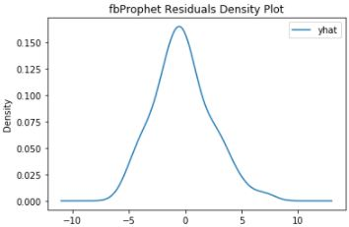
ARIMA VS FBPROPHET MODELS RESIDUALS
ARIMA
MEAN :
KURTOSIS :
SKEW :
IDEAL
MEAN : 0
KURTOSIS : 3
SKEW : 0
FBPROPHET
MEAN :
KURTOSIS :
SKEW :
The closer to Ideal scores, the better the data was preprocessed and modeled. That downward trend in the line plots are not ideal.

Slide 13
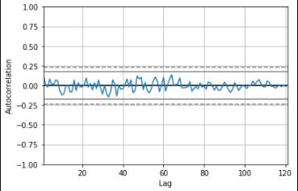
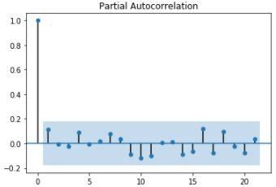
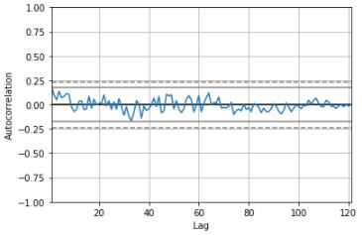
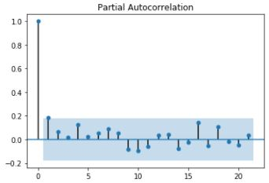
ARIMA VS FBPROPHET MODELS RESIDUALS
ARIMA RESIDUALS ACF - PACF
FBPROPHET RESIDUALS ACF - PACF
These plots tell me that the errors are not autocorrelated, which a general assumption of linear models.

Slide 14

User Specification
Examples of how these models and this data can be used

Slide 15
User Specification Agencies Overseeing Law Enforcement
Agencies overseeing law enforcement operations with an interest in maintaining and improving public trust in law enforcement could use these reports as a starting point for investigating "use of force" in very specific situations(referring to the returned data frame) and uncovering trends(referring to the components report). For example, if suicide is on the rise and these encounters are resulting in death then resources can be allocated to have professionals (with the proper negotiating skills) accompany law enforcement in those areas. In an attempt to address the problems of the public we should be, thinking national but acting locally situations. Needs investigations of this kind could be done on a local, state-wide, or national level depending on the jurisdiction of the agency.

Slide 16
User Specification Law Enforcement
I believe law enforcement agencies working along with an "outside" data organizer like FatalEncounter.org would benefit from making these reports public and quickly accessible so that the narrative of policing starts with honesty and transparency. If the data comes from law enforcement and is verified with other public sources then, people are more likely to trust it and those agencies over time, as long as there are no "conflicts of interest."

Slide 17
User Specification Nonprofit and Civil Rights Groups
Once the data is widely available then these groups could use it to create databases of incidents and results or amendments made to ensure fewer of these incidents occur by appealing to agencies for the need of consistent accountability. These organizations should also make their information open to the general public and as we progress towards being more routinely consistent this will also help reinforce public trust and transparency.

Slide 18
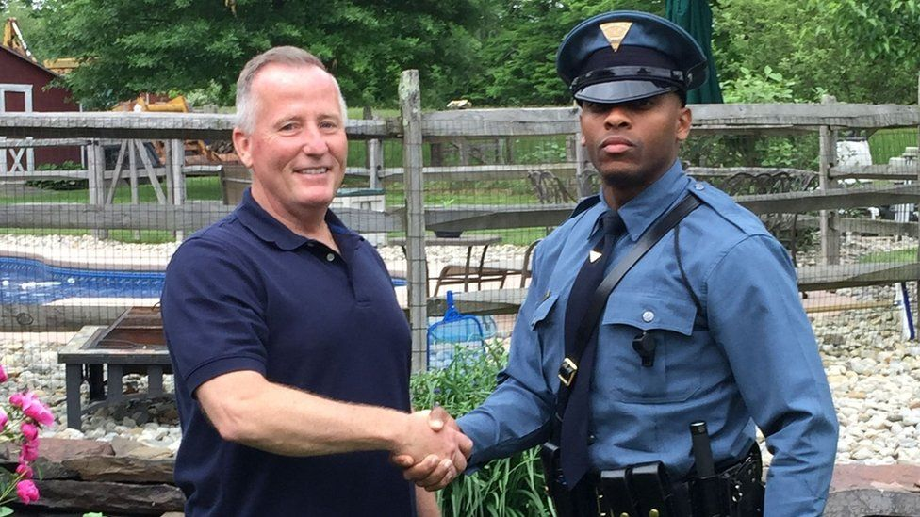
Conclusion
I know the current political environment has polarized the US citizens into framing the subject of policing into partisan hate or love categories. But let's take a step back and be honest, we all want transparent law and order and equal treatment under the law. That is the idea that unites us, creating a transparent system with checks and balances that hold people accountable is how we get there. It's unlikely that public trust will be created or restored among every part of the US population immediately, but with transparency, accountability, and consistency over time, it is achievable.

